Slide 1

M21DG0303 - Minor Project Master of Science in Data Science - M.Sc.(DS) III Semester – 2024
School of Computer Science and Applications

Slide 2
ANALYZING FLOOD DATASET USING MACHINE LEARNING ALGORITHMS
Presented by: AMITH B R (R22DG065)
BHOOMIKA B A (R22DG008)
Under the Guidance of: ABHAY KUMAR SRIVASTAV
Assistant Professor

Slide 3
AGENDA
Abstract
Introduction
I. Problem Statement
II. Motivation
Software Requirements
Dataset and Description
Data Preparation
Model Planning
Model Building
Results
Conclusion and Future Enhancements
References

Slide 4
ABSTRACT
Flood is a natural disaster that poses significant threats to both human lives and infrastructure making it a pressing global concern. With climate change, urbanization and land use changes amplifying the frequency and intensity of extreme weather events, the need for accurate and timely flood prediction has never been more critical. There will be need of development of robust and accurate predictive models. The dataset used in our study is the Flood Dataset which we have collected data from different government websites. The primary objective of this study is to develop robust models capable of accurately predicting the occurrence of flood. The Partial Least Squares-Structural Equation Modelling (PLS-SEM), Long Short-Term Memory (LSTM) and XG Boost Regressor models are utilized for feature extraction and prediction tasks. The analysis conducted demonstrates the effectiveness of the proposed methodology having a Root Mean Squared Error relatively low with the XG Boost Regressor compared to other models. Hence, we can tell that the XG Boost Regressor is a good fit model for our data.

Slide 5
INTRODUCTION
A flood is an overflow of water onto land that is usually dry.
This overflow can occur for various reasons and may range from localized, minor events to large scale disasters with widespread impacts.
Flooding can be caused by natural processes such as heavy rainfall, snowmelt, storm surges from hurricanes or tropical cyclones and overflow of rivers, lakes, or coastal areas. Additionally, human activities such as urbanization, deforestation and changes in land use can contribute to flooding.
Machine Learning is a subset of Artificial Intelligence which improves systems to learn from the data, identify the patterns and make predictions without complicated programming. It can leverage real-time data from various sources.
In our project we have used various machine learning techniques such as Partial Least Squares-Structural Equation Modeling (PLS-SEM), Long Short-Term Memory (LSTM) and XG Boost to predict floods.
By implementing these models, we can stop the huge loss of lives and damage of infrastructure.

Slide 6
I. PROBLEM STATEMENT
The problem of flood prediction can be addressed using various machine learning techniques. The main objective is to develop a model that can accurately predict the occurrence of a flood in a particular area based on rainfall data.
II. MOTIVATION
Early prediction of flood can enable timely evacuation and preparation reducing the risk to human lives and property damage. By providing accurate and timely information to residents and emergency responders can enhance public safety during the flood.

Slide 7
SOFTWARE REQUIREMENTS
Operating System: Windows 11 OS with 64-bit architecture.
Programming Language: PYTHON
Python is a computer programming language often used to build websites and software, automate tasks, and conduct data analysis. It is an interpreted, object-oriented, high-level programming language with dynamic semantics.
Integrated Development Environment (IDE): JUPYTER NOTEBOOK
The Jupyter Notebook is the original web application for creating and sharing computational documents. It offers a simple, streamlined, document-centric experience. It is a fully open-source product and users can use every functionality available for free.

Slide 8
SOFTWARE REQUIREMENTS
Machine Learning Frameworks: TensorFlow, Keras and sklearn.
Machine Learning Frameworks are the tools that lets software developers, data scientists and machine learning engineers build machine learning models. We have used the frameworks such as TensorFlow, Keras and Sklearn.

Slide 9
Dataset and description
The dataset has been prepared by collecting data from websites such as Indian Meteorological Department, Google, Kaggle And Some other Government Websites.
In our dataset there are 18 columns and 792 rows which constitute to 14,256 values providing an overview of the occurrence of floods from year 1996 to 2016. It has the following features mentioned below.
Station_Name: Different Geographical region of India.
Max_Temp: The maximum temperature recorded.
Min_Temp: The minimum temperature recorded.
Rainfall: The total annual rainfall measured in millimeters.
Wind Speed: The rate at which air is moving horizontally.

Slide 10
Bright_Sunshine : The duration of the period for which the direct solar irradiance.
Relative_Humidity : The amount of atmospheric moisture present relative to the amount that would be present if the air were saturated.
Latitude: The geographic coordinate that specifies the north-south position of location.
Longitude: The geographic coordinate that specifies the east-west position of location.
Flood: Whether there will be occurrence flood or no.

Slide 11
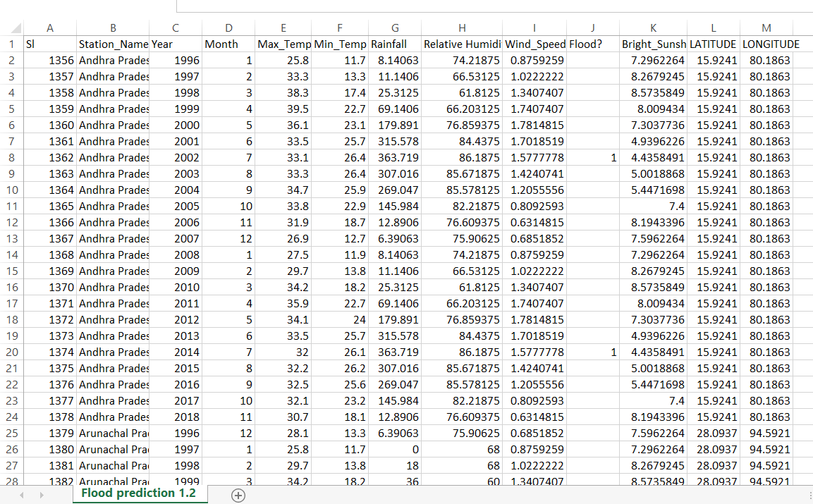
This is the dataset we have used for our analysis.

Slide 12
DATATYPES IN OUR DATASET

Slide 13
DATA PREPARATION
Data Preparation is a crucial step in the data analysis process, it involves cleaning, transforming and organizing the raw data into a format suitable for analysis.
1. Data Cleaning
Data Cleaning is a process of identifying and correcting
errors, inconsistencies and inaccuracies in raw datasets.
In our dataset we can see that we have 685 missing
values for the flood column and hence we will remove
that column as we are predicting the occurrence of
flood through rainfall.
There are no duplicate values in the dataset.
13

Slide 14
2. Data Transformation
Data Transformation is a process of modifying the original data to make it more understandable and compatible.
Normalization: It is the process of translating data into the range [0, 1].
Reshaping: It involves changing the structure of the data to make it suitable for specific analysis.
Encoding: It is a process of converting categorical variables into a numerical format suitable for machine learning algorithms.

Slide 15
3. Handling Outliers
An outlier detection is used to detect anomalous observations or samples that do not fit the normal statistical distribution of a dataset. Box plot is normally used to detect outliers. In Our dataset there are some outliers in the Rainfall column. We have transformed the values by using data transformation techniques.

Slide 16
4. Data Splitting
The process of dividing the dataset into training and test sets for model training and evaluation. Generally, we split the dataset into 70:30 or 80:20. In our dataset we have taken 80:20 it means, 80 percent data taken to train and 30 percent data taken to test. For this task, we will import train_test_split from model_selection library of scikit.
Feature Scaling
Standardization: It is a method of feature scaling in which data values are rescaled to fit the distribution between 0 and 1 using mean and standard deviation as the base to find specific values.
Min-Max Scalar Technique: MinMax Scaler shrinks the data within the given range, usually of 0 to 1.

Slide 17
6. Exploratory Data Analysis (EDA)
It is a process where we can understand the distribution of variables, identify patterns and gain insights before moving on to further analysis.
Through this plot we can know how the data
is distributed or clustered around certain values
or ranges.

Slide 18
Distribution Of The Rainfall Data That Is How Often There Is Rainfall

Slide 19
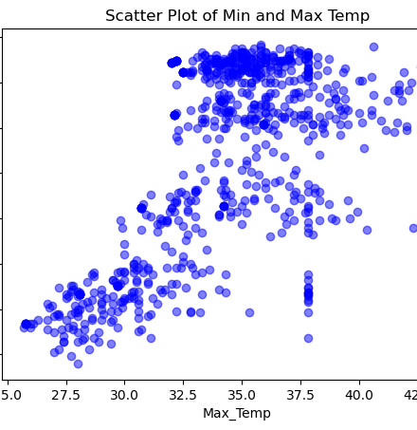
Relationship Between Maximum And Minimum Temperature Where Darker Shade Is Max Temp And Lighter Shade Is Min Temp

Slide 20
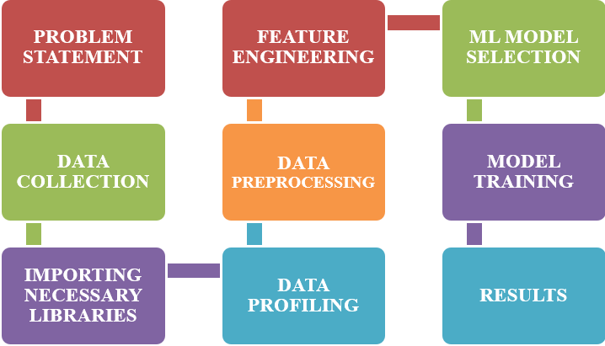
MODEL PLANNING

Slide 21
Problem Statement:
This clearly defines the scope of our project that is prediction of floods. In our project we predict flood using various hybrid machine learning models.
Data Collection:
Gathering historical and real-time data from various sources.
Importing Necessary Libraries:
Various libraries have been imported for designing a system for flood prediction using machine learning models. It will handle data processing, machine learning tasks, visualization and more. In our project various libraries are imported like Pandas, NumPy, Matplotlib, LinearRegression, mean_squared_error, MinMaxScaler, IsolationForest, Sequential, Dense, LSTM, make_regression, train_test_split, StandardScaler, PCL, PLS Regression, Sequential, Pickle, XGBRegressor.
Data Profiling:
Data profiling refers to the process of examining, analyzing, reviewing and summarizing data sets to gain insight into the quality of data. Data quality is a measure of the condition of data based on factors such as its accuracy, completeness, consistency, timeliness and accessibility.

Slide 22
Data Preprocessing:
It cleans and preprocesses the data to handle missing values, outliers and inconsistencies. It Aggregates or interpolates data to a consistent time resolution. It Normalize or standardize numerical features.
Feature Engineering:
This will help to extract relevant features or parameters which are required for flood prediction. Feature engineering is a crucial step in designing a flood prediction system using machine learning models. It involves selecting, transforming, or creating features from the raw data to enhance the model's ability to make accurate predictions.
Machine Learning Model Selection:
We can choose the appropriate machine learning algorithms which is suitable for our data to predict floods. Here are some models what we can use for flood prediction.
Regression Models: Linear regression, decision trees, random forests.
Time Series Models: LSTM (Long Short-Term Memory), GRU (Gated Recurrent Unit).
Ensemble Models: Boosting or stacking for improved accuracy.
In our analysis we have used PLS-SEM Model, LSTM Model and XG Boost Regressor.

Slide 23
Model Training:
We split our dataset into training and testing sets. We train the selected models using the data we have collected. We will use historical data to teach your machine learning models to make accurate predictions.
Results:
For flood prediction models, evaluation metrics should reflect the model's ability to accurately predict and assess the severity of flood events. The choice of metrics depends on the nature of the problem and the specific requirements of the application.
In our analysis we have taken the Root Mean Squared Error to evaluate our results. RMSE is a popular evaluation metric for regression problems because it not only calculates how close the prediction is to the actual value on average, but it also indicates the effect of large errors.

Slide 24
MODEL BUILDING – XG BOOST REGRESSOR
Load the Flood Dataset and Import Necessary Libraries
Splitting dataset into training set and testing set
Apply XGBoost Model
Train the Model
Make Predictions
Preprocess and Preparing the data
Feature Selection
Evaluating the performance using the metric RMSE

Slide 25
MODEL BUILDING – Long short-term memory
Load Flood Dataset
Importing Necessary Libraries
Data Preprocessing
Feature Selection
Splitting the data into training and testing set
Applying the LSTM Model
Training the model
Evaluate the performance using the metric RMSE

Slide 26
MODEL BUILDING – pls-seM
Import the flood dataset
Importing necessary Libraries
Data Preprocessing
Define Measurement Model using Sequential library
Assess Measurement model
Define Structural Model using Dense library
Evaluate Structural Model
Validate the model
Interpret and Report Results

Slide 27
RESULTS
We have used various regression metrics to interpret the model performance. We will consider the Root Mean Squared Error as it is a popular metric for regression due to its sensitivity to large errors, differentiability for optimization algorithms, alignment with statistical properties like standard deviation and balanced handling of outliers.
MODELS USED | MEAN SQUARED ERROR | MEAN ABSOLUTE ERROR | ROOT MEAN SQUARED ERROR | R-SQUARED
PLS-SEM | 0.0148 | 0.098 | 0.121 | 0.999
LSTM | 0.067 | 0.1622 | 0.26 | 0.323
XG BOOST | 0.004 | 0.528 | 0.062 | 0.999

Slide 28
CONCLUSION
The flood prediction represents a significant step forward in using technologies to mitigate the impact of floods on communities and infrastructure. In this study, we proposed a framework for prediction of floods using machine learning models. We have used the metric Root Mean Squared Error as it is a popular metric for regression because it combines the advantages of MSE (Mean Squared Error) while having the same scale as the target variable to predict the accurate model for the data. The models which will have relatively low RMSE values will be accurate models. According to our analysis the XG Boost Regressor model is an accurate model with an RMSE value of 0.062. From this model we can accurately predict the occurrence of floods. These models identify the patterns and give accurate predictions. By using these models, we can stop huge loss of human life and infrastructure. From this study, we can conclude that we can predict the occurrence of flood beforehand and take precautionary measures to stop the huge loss of lives and damage of infrastructure.

Slide 29
FUTURE ENHANCEMENT
In the future scope, We intend to investigate prediction approach with the revised data set and employ the most accurate and relevant machine learning algorithms for detection.

Slide 30
REFERENCES
[1] - Zongjia Zhang, Jun Liang, Yujue Zhou, Zhejun Huang, Jie Jiang3, Junguo Liu.2022. Amulti-strategy-mode waterlogging-prediction framework for urban flood depth. Natural hazards and earth system sciences.
[2] - Md Abdullah Al Mehedi, Virginia Smith ,Hossein Hosseiny , Xun.2022. Unraveling The Complexities of Urban Flood Hydraulics through AI. Creative Commons Attribution.
[3] - Elham Rafiei-Sardooi , Ali Azareh b , Bahram Choubin c , Amir H. Mosavi.2021. Evaluating urban flood risk using hybrid method of TOPSIS and machine learning. International Journal of Disaster Risk Reduction.
[4] - Farhana Parvin, Sk Ajim Ali, Beata Calka, Elzbieta Bielecka.2022. Urban flood vulnerability assessment in a densely urbanized city using multi factor analysis and machine learning algorithms. Theoretical and Applied Climatology.
[5] - Wei Zhu, Zhe Cao and Bin He, Pingping Luo , Zeming Tang , Yuzhu Zhang.2022. Urban Flood-Related Remote Sensing: Research Trends, Gaps and Opportunities. MDPI stays neutral with regard to jurisdictional claims in published maps and institutional affiliations.
[6] - Wenting Zhang , Bin Hu, Yongzhi Liu, Xingnan Zhang and Zhixuan Li.2023. Urban Flood Risk Assessment through the Integration of Natural and Human Resilience Based on Machine Learning Models. https://www.mdpi.com/journal/remotesensing.
[7] - Xingyu Yan, Kui Xu, Wenqiang Feng, Jing Chen.2021. A Rapid Prediction Model of Urban Flood Inundation in a High-Risk Area Coupling Machine Learning and Numerical Simulation Approaches. International J Disaster Risk Science.
[8] - Fereshteh Taromideh , Ramin Fazloula, Bahram Choubin, Alireza Emadi.2022. Urban Flood-Risk Assessment: Integration of Decision-Making and Machine Learning. M DPI stays neutral with regard to jurisdictional claims in published maps and institutional affiliations.
[9] - Huiliang Wang, Hongfa Wang, Zening Wu and Yihong Zhou.2021. Using Multi-Factor Analysis to Predict Urban Flood Depth Based on Naive Bayes. MDPI stays neutral with regard to jurisdictional claims in published maps and institutional affiliations.
[10] - Wenkai Li , Yuanchi Liu , Ziyue Liu , Zhen Gao , Huabing Huang.2022. APositive-Unlabeled Learning Algorithm for Urban Flood Susceptibility Modeling. MDPI stays neutral with regard to jurisdictional claims in published maps and institutional affiliations.
[11] – Zifeng Guo, JoaoP.Leit ao, NunoE.Simões, VahidMoosav.2020. Data driven flood emulation: Speeding up urban flood predictions by deep convolutional neural network. Chartered Institution of Water And Environmental Management.
[12] - Junfei Chen, Qian Li, Huimin Wang, Menghua Deng .2019. A Machine Learning Ensemble Approach Based on Random Forest and Radial Basis Function Neural Network for Risk Evaluation of Regional Flood Disaster: A Case Study of the Yangtze River Delta, China. International Journal of Environmental Research and public health.
[13] - Mahya Norallahi, Hesam Seyed Kabol.2021. Urban flood hazard mapping using machine learning models: GARP, RF, MaxEnt and NB. Natural Hazards conferences.
[14] - Candace Agonafir.2022. A Citizen-Science Approach for Urban Flood Risk Analysis Using Data Science and Machine Learning. A dissertation submitted in partial fulfillment of the requirements for the degree of Doctor of Philosophy
[15] - Indra Riyanto , Mia Rizkinia, Rahmat Arief.2022. Three-Dimensional Convolutional Neural Network on Multi-Temporal Synthetic Aperture Radar Images for Urban Flood Potential Mapping in Jakarta. MDPI stays neutral with regard to jurisdictional claims in published maps and institutional affiliations.

Slide 31
REFERENCES
[16] - MOHAMMEDMOISHIN RAMENDRA PRASAD ,RAVINESH C. DEO ,(Senior Member, IEEE), NAWINRAJ.2021. Designing Deep-Based Learning Flood Forecast Model With ConvLSTM Hybrid Algorithm.IEEE Access conference.
[17] - Marcel Motta, Miguel de Castro Neto, Pedro Sarmento.2021. A mixed approach for urban flood prediction using Machine Learning and GIS. published by Elsevier.
[18] - Zhufeng Li, Haixing Liu , Chunbo Luo and Guangtao Fu.2021. Assessing Surface Water Flood Risks in Urban Areas Using Machine Learning. MDPI stays neutral with regard to jurisdictional claims in maps and institutional affiliations.
[19] - Ahad Hasan Tanim , Callum Blake McRae, Hassan Tavakol‐Davani.2022. Flood Detection in Urban Areas Using Satellite Imagery and Machine Learning . MDPI stays neutral with regard to jurisdictional claims in published maps and institutional affiliations.
[20] - Detchphol Chitwatkulsiri and Hitoshi Miyamoto.2023. Real-Time Urban Flood Forecasting Systems for Southeast Asia A Review of Present Modelling and Its Future Prospects. Department of Civil Engineering, Shibaura Institute of Technology.
[21] - Cailin Li , Na Sun, Yihui Lu , Baoyun Guo , Yue Wang.2022. Review on Urban Flood Risk Assessment. https://www.mdpi.com/journal/sustainability.
[22] - Faria T. Zahura, Jonathan L. Good all, Mohamed M.Morsy ,and Madhur Behl ,Jeffrey M. Sadler .2020.Training Machine Learning Surrogate Models From a High‐Fidelity Physics‐Based Model: Application for Real‐Time Street‐Scale Flood Prediction in an Urban Coastal Community. RESEARCH ARTICLE.
[23] - Tarik Bouramtane , Ilias Kacimi , Khalil Bouramtane , Maryam Aziz , Shiny Abraham , Khalid Omari.2021. Multivariate Analysis and Machine Learning Approach for Mapping the Variability and Vulnerability of Urban Flooding: The Case of Tangier City, Morocco. MDPI stays neutral with regard to jurisdictional claims in published maps and institutional affiliations.
[24] - Zening Wu, Bingyan Ma, Huiliang Wang, Caihong Hu, Hong Lv.2021. Identification of Sensitive Parameters of Urban Flood Model Based on Artificial Neural Network. Water Resources Management (2021).
[27] - Candace Agonafir Dave Radell d a , Tarendra Lakhankar , Naresh Devineni.2023. A review of recent advances in urban flood research.Elsevier.
[28] - Yaoxing Liao, Zhaoli wang , Chengguang Lai , Chon g Yu.2023. A Framework on Fast Mapping of Urban Flood Based on a Multi Objective Random Forest ModeLInternational Journal of Disaster Risk Science.
[29] - Gang Zhaoa ,BoPanga, Zongxue Xu , Dingzhi Penga, Liyang Xu.2019. Assessment of urban flood susceptibility using semi-supervised machine learning model. Science Of Total Environment.
[30] - Yao Li a a, Frank Badu Osei , Tangao Hu b, Alfred Stein.2023. Urban flood susceptibility mapping based on social media data in Chengdu city, China. Urban flood susceptibility mapping Social media data.

Slide 32
Thank You

